Slide 1
Intro to Cloud Computing CS4037 (BCS-6A) Lecture 02
Instructor: Danyal Farhat
Lecturer, Department of Computer Science, FAST
31 January, 2023

Slide 2
Module 1: Cloud Concepts Overview
AWS Academy Cloud Foundations
© 2019 Amazon Web Services, Inc. or its Affiliates. All rights reserved.

Slide 3

Module overview
Topics
Introduction to cloud computing
Advantages of cloud computing
Introduction to Amazon Web Services (AWS)
AWS Cloud Adoption Framework (AWS CAF)
Knowledge check

Slide 4
Module objectives
After completing this module, you should be able to:
Define different types of cloud computing models
Describe six advantages of cloud computing
Recognize the main AWS service categories and core services
Review the AWS Cloud Adoption Framework (AWS CAF)

Slide 5
Section 1: Introduction to cloud computing
Module 1: Cloud Concepts Overview

Slide 6
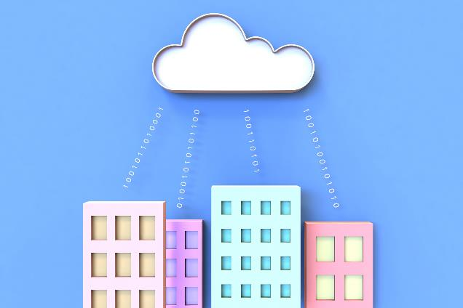
Cloud computing defined
Cloud computing is the on-demand delivery of compute power, database, storage, applications, and other IT resources via the internet with pay-as-you-go pricing.

Slide 7
Cloud computing defined (Cont.)
The resources run on server computers that are located in large data centers in different locations around the world.
When you use a cloud service provider like AWS, that service provider owns the computers that you are using.
The resources can be used together like building blocks to build solutions that help meet business goals and satisfy technology requirements.

Slide 8
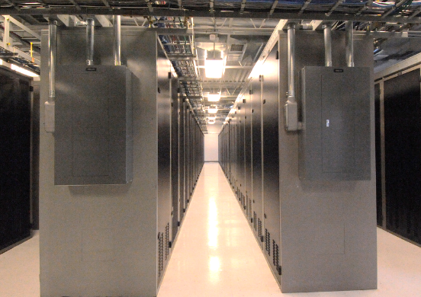

Infrastructure as software
Cloud computing enables you to stop thinking of your infrastructure as hardware, and instead think of (and use) it as software.

Slide 9
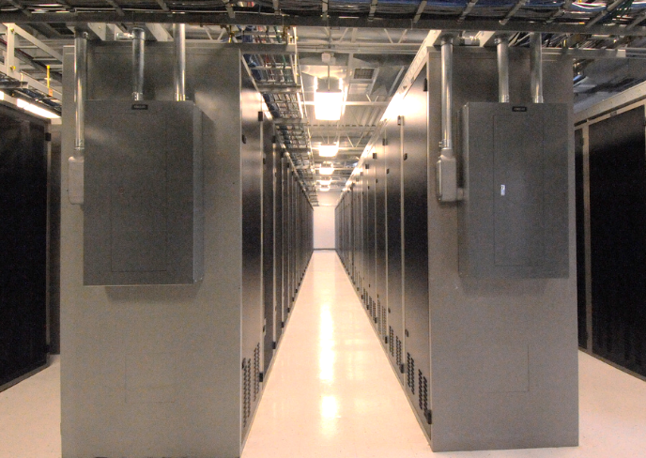
Traditional computing model
Infrastructure as hardware
Hardware solutions:
Require space, staff, physical security, planning, capital expenditure (Capex)
Have a long hardware procurement cycle
Require you to provision capacity by guessing theoretical maximum peaks
Notes:
In the traditional computing model, infrastructure is thought of as hardware. Hardware solutions are physical, which means they require space, staff, physical security, planning, and capital expenditure.
In addition to significant upfront investment, another prohibitive aspect of traditional computing is the long hardware procurement cycle that involves acquiring, provisioning, and maintaining on-premises infrastructure (Gen 10 Server Price 2800 USD 0.65 million PKR.).
With a hardware solution, you must ask if there is enough resource capacity or sufficient storage to meet your needs, and you provision capacity by guessing theoretical maximum peaks. If you don’t meet your projected maximum peak, then you pay for expensive resources that stay idle. If you exceed your projected maximum peak, then you don’t have sufficient capacity to meet your needs. And if your needs change, then you must spend the time, effort, and money required to implement a new solution.
For example, if you wanted to provision a new website, you would need to buy the hardware, rack and stack it, put it in a data center, and then manage it or have someone else manage it. This approach is expensive and time-consuming.

Slide 10

Cloud computing model
Infrastructure as software
Software solutions:
Are flexible
Can change more quickly, easily, and cost-effectively than hardware solutions
Eliminate the undifferentiated heavy-lifting tasks
You can treat cloud resources as temporary and disposable
Different level of control, flexibility, and management
Notes:
By contrast, cloud computing enables you to think of your infrastructure as software. Software solutions are flexible. You can select the cloud services that best match your needs, provision and terminate those resources on-demand, and pay for what you use. You can elastically scale resources up and down in an automated fashion. With the cloud computing model, you can treat resources as temporary and disposable. The flexibility that cloud computing offers enables businesses to implement new solutions quickly and with low upfront costs.
Compared to hardware solutions, software solutions can change much more quickly, easily, and cost-effectively.
Cloud computing helps developers and IT departments avoid undifferentiated work like procurement, maintenance, and capacity planning, thus enabling them to focus on what matters most.
As cloud computing has grown in popularity, several different service models and deployment strategies have emerged to help meet the specific needs of different users. Each type of cloud service model and deployment strategy provides you with a different level of control, flexibility, and management. Understanding the differences between these cloud service models and deployment strategies can help you decide what set of services is right for your needs.

Slide 11

Cloud service models
IaaS
(infrastructure as a service)
PaaS
(platform as a service)
SaaS
(software as a service)
More control over IT resources
Less control over IT resources
Notes:
There are three main cloud service models. Each model represents a different part of the cloud computing stack and gives you a different level of control over your IT resources:

Slide 12
Cloud service models (Cont.)
Infrastructure as a service (IaaS)
Services in this category are the basic building blocks for cloud IT.
Provides with access to networking features, computers (virtual or on dedicated hardware), and data storage space.
Provides highest level of flexibility and management control over IT resources.
It is the most similar to existing IT resources that many IT departments and developers are familiar with today.

Slide 13
Cloud service models (Cont.)
Platform as a service (PaaS)
Services in this category reduce the need to manage the underlying infrastructure (usually hardware and operating systems).
PaaS enables to focus on the deployment and management of applications.
Example includes containers and serverless computing.

Slide 14
Cloud service models (Cont.)
Software as a service (SaaS)
Services in this category provide a completed product that the service provider runs and manages.
In most cases, software as a service refers to end-user applications.
With a SaaS offering, you do not have to think about how the service is maintained or how the underlying infrastructure is managed.

Slide 15
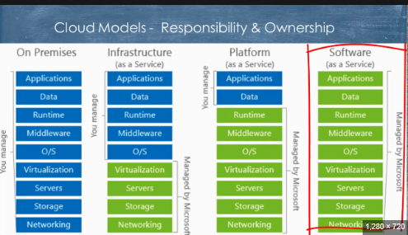
Cloud Model – Responsibility and Ownership

Slide 16
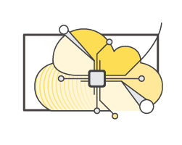
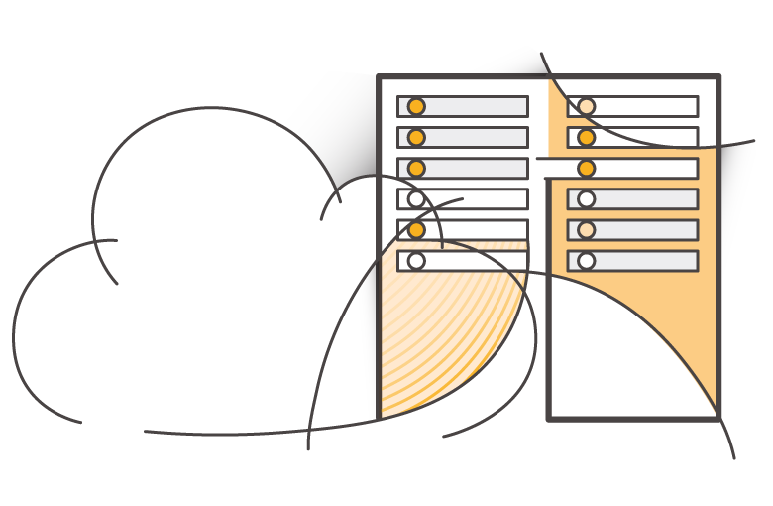
Cloud computing deployment models
Cloud
Hybrid
On-premises (private cloud)
Notes:
There are three main cloud computing deployment models, which represent the cloud environments that your applications can be deployed in.

Slide 17
Cloud computing deployment models (Cont.)
Cloud / Public Cloud
A cloud-based application is fully deployed in the cloud, and all parts of the application run in the cloud.
Applications in the cloud have either been created in the cloud or have been migrated from an existing infrastructure to cloud.
Cloud-based applications can be built on low-level infrastructure pieces or they can use higher-level services that provide abstraction from the management, architecting, and scaling requirements of core infrastructure.

Slide 18
Cloud computing deployment models (Cont.)
Hybrid
A hybrid deployment is a way to connect infrastructure and applications between cloud-based resources and existing (on-premises) resources that are not located in the cloud.
Enables an organization to extend and grow their infrastructure into the cloud while connecting cloud resources to internal systems.
Examples are Backup as a Service (BaaS) and Disaster Recovery as a Service (DRaaS) etc.

Slide 19
Cloud computing deployment models (Cont.)
On-Premises / Private Cloud
Deploying resources on-premises, using virtualization and resource management tools, is called private cloud.
While on-premises deployment does not provide many of the benefits of cloud computing, it is sometimes sought for its ability to provide dedicated resources.
In most cases, this deployment model is the same as legacy IT infrastructure, but it might also use application management and virtualization technologies to increase resource utilization.
50 employees in a company.

Slide 20





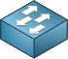
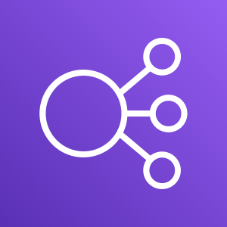
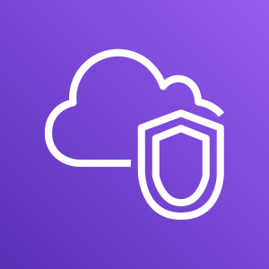

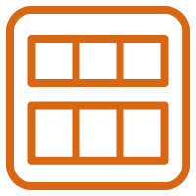
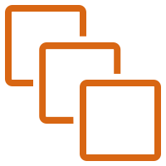
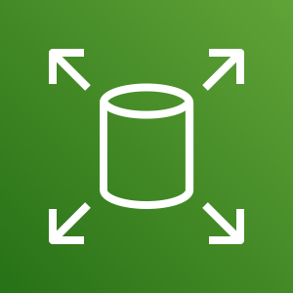
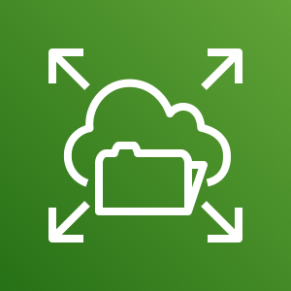

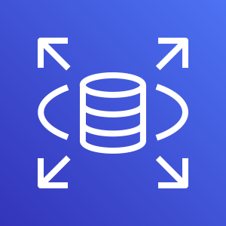
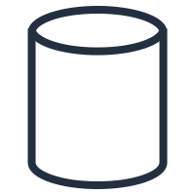

Similarities between AWS and traditional IT
Traditional, on-premises IT space
AWS
Security
Security groups
Firewalls
ACLs
Administrators
Network ACLs
IAM
Networking
Router
Network pipeline
Switch
Elastic Load Balancing
Amazon VPC
On-premises servers
Compute
AMI
Amazon EC2 instances
Storage and database
DAS
SAN
NAS
RDBMS
Amazon EBS
Amazon EFS
Amazon S3
Amazon RDS
Notes:
There are many similarities between AWS and the traditional, on-premises IT space:
AWS security groups, network access control lists (network ACLs), and AWS Identity and Access Management (IAM) are similar to firewalls, access control lists (ACLs), and administrators.
Elastic Load Balancing and Amazon Virtual Private Cloud (Amazon VPC) are similar to routers, network pipelines, and switches.
Amazon Machine Images (AMIs) and Amazon Elastic Compute Cloud (Amazon EC2) instances are similar to on-premises servers.
Amazon Elastic Block Store (Amazon EBS), Amazon Elastic File System (Amazon EFS), Amazon Simple Storage Service (Amazon S3), and Amazon Relational Database Service (Amazon RDS) are similar to direct attached storage (DAS), storage area networks (SAN), network attached storage (NAS), and a relational database management service (RDBMS).

Slide 21
Similarities between AWS and traditional IT (Cont.)
AMIs are used to initialize Amazon EC2 instances
Amazon EBS represents a hard disk that attaches to virtual machine
Amazon EBS is equivalent to DAS to the physical machine.
Amazon EFS also attaches to VM but it represents traditional SAN.
Amazon S3 provides the ability to store files using internet, and is equivalent NAS.
With AWS services and features, you can do almost everything that you would want to do with a traditional data center.

Slide 22
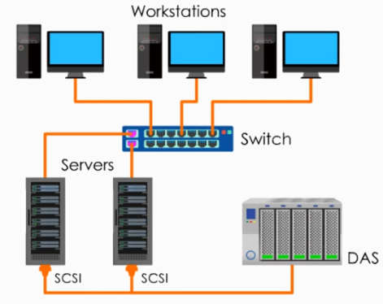
Traditional Storage Models
Direct Attached Storage (DAS)
DAS is a Simple, low-maintenance, low-cost data storage solution.
Data storage system is connected directly to the servers through SCSI or other connections.
Similar to an external hard drive or thumb drive inserted into a PC.
Notes:
Small Computer System Interface (SCSI) is a set of standards for physically connecting and transferring data between computers and peripheral devices.

Slide 23
Traditional Storage Models
Direct Attached Storage (DAS)
Not designed for sharing data across the network.
Not suitable for businesses that are growing quickly since it is not designed for scalability.
Suitable for small businesses that share data locally with little IT support.

Slide 24
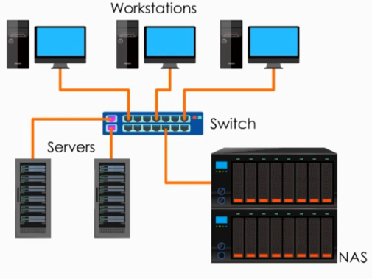
Traditional Storage Models
Network Attached Storage (NAS)
NAS offers dedicated file-level storage through a network.
Allows both local and remote access to data through a network connection.
To the switch, NAS is just one node on a network.

Slide 25
Traditional Storage Models
Network Attached Storage (NAS)
Compared with DAS, NAS has many benefits.
Can be available 24/7
Shared among different user groups through network
Best suitable for small and medium sized businesses looking for reliable, flexible, scalable, minimal-maintenance data storage solution.

Slide 26
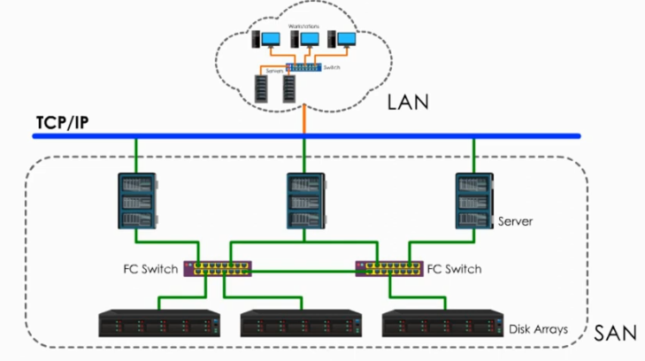
Traditional Storage Models
Storage Area Network (SAN)
SAN is a dedicated, high-performance storage system.
Provides block-level storage of data.
SAN technology is based on Fiber Channel – a fast data transfer protocol – to transfer data.

Slide 27
Traditional Storage Models
Storage Area Network (SAN)
As a separate network, SAN is an environment that can be accessed by TCP/IP networks, but it is not affected by TCP/IP network traffic.
Servers are connected with storage RAIDs through Fiber Channel switch.

Slide 28
Traditional Storage Models
Storage Area Network (SAN)
RAID (Redundant Array of Inexpensive Disks or Redundant Array of Independent Disks) is a data storage virtualization technology that combines multiple physical disk drive components into one or more logical units for the purposes of data redundancy, performance improvement, or both.

Slide 29
Traditional Storage Models
Storage Area Network (SAN)
Two alternate SAN technologies to Fiber Channel include iSCSI (internet SCSI) and FCoE (Fiber Channel over Ethernet).
SAN storage is very sophisticated system designed to support complex, mission-critical business applications and databases.
SAN is used in enterprise-level companies, data centers or cloud computing environments.

Slide 30
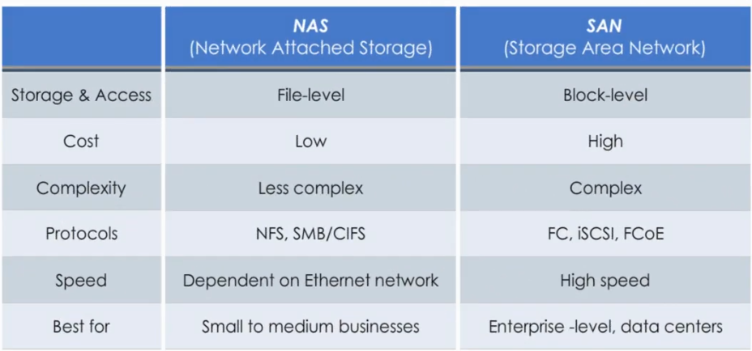
Traditional Storage Models – Difference Between NAS and SAN
Notes:
Network File Sharing protocol (NFS protocol), Server Message Block protocol (SMB protocol), and Common Internet File System protocol (CIFS protocol) are used in NAS.

Slide 31

Section 1 key takeaways
Cloud computing is the on-demand delivery of IT resources via the internet with pay-as-you-go pricing.
Cloud computing enables you to think of (and use) your infrastructure as software.
There are three cloud service models: IaaS, PaaS, and SaaS.
There are three cloud deployment models: cloud, hybrid, and on-premises or private cloud.
Almost anything you can implement with traditional IT can also be implemented as an AWS cloud computing service.
Notes:
Some key takeaways from this section of the module include:
Cloud computing is the on-demand delivery of IT resources via the internet with pay-as-you-go pricing.
Cloud computing enables you to think of (and use) your infrastructure as software.
There are three cloud service models: IaaS, PaaS, and SaaS.
There are three cloud deployment models: cloud, hybrid, and on-premises or private cloud.
There are many AWS service analogs for the traditional, on-premises IT space.

Slide 32
Section 2: Advantages of cloud computing
Module 1: Cloud Concepts Overview
Notes:
Section 2: Advantages of cloud computing
Why are so many companies interested in moving to the cloud? This section presents six advantages of cloud computing.

Slide 33


Trade capital expense for variable expense
Capital
Data center investment based on forecast
Pay only for the amount you consume

Slide 34
Trade capital expense for variable expense (Cont.)
Capital expenses (capex) are funds that a company uses to acquire, upgrade, and maintain physical assets such as property, industrial buildings, or equipment.
For example, while building a data center, you must pay for everything in the data center whether you use it or not.
A variable expense is an expense that the person who bears the cost can easily alter or avoid.
Instead of investing heavily in data centers and servers before you know how you will use them, you can pay only when you consume resources and pay only for the amount you consume.

Slide 35

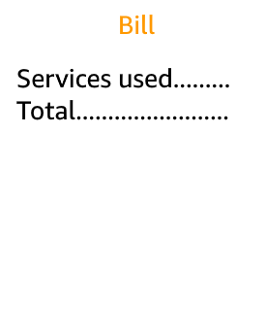

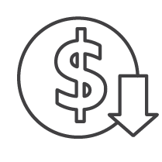
Massive economies of scale
Because of aggregate usage from all customers, AWS can achieve higher economies of scale and pass savings on to customers.
AWS Cloud
Economies of scale
Savings
Notes:
Advantage #2—Benefit from massive economies of scale: By using cloud computing, you can achieve a lower variable cost than you can get on your own. Because usage from hundreds of thousands of customers is aggregated in the cloud, providers such as AWS can achieve higher economies of scale, which translates into lower pay-as-you-go prices.

Slide 36
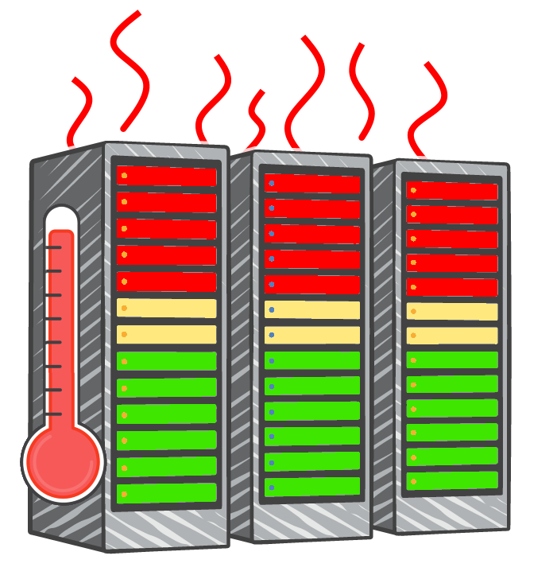
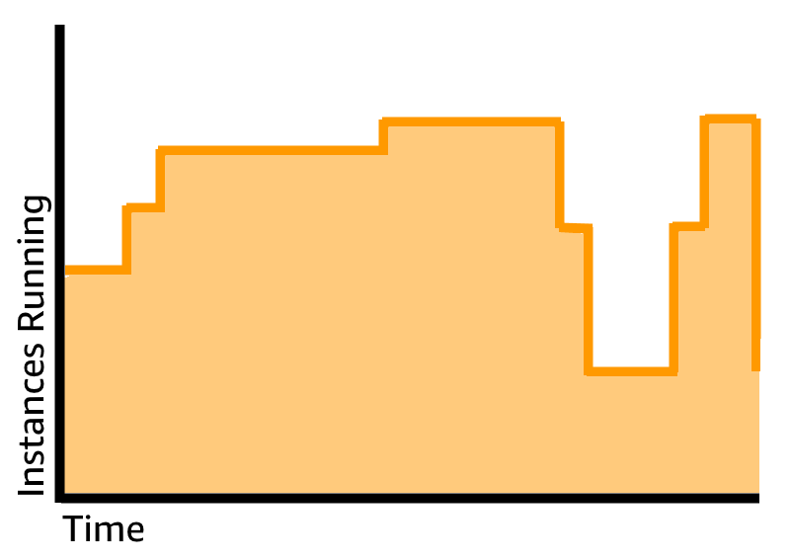
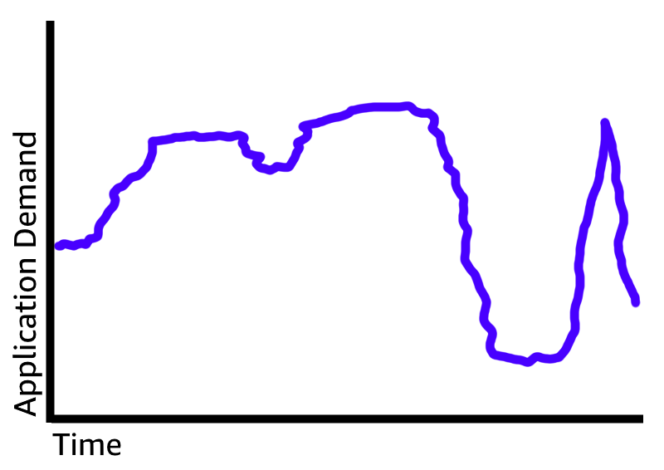
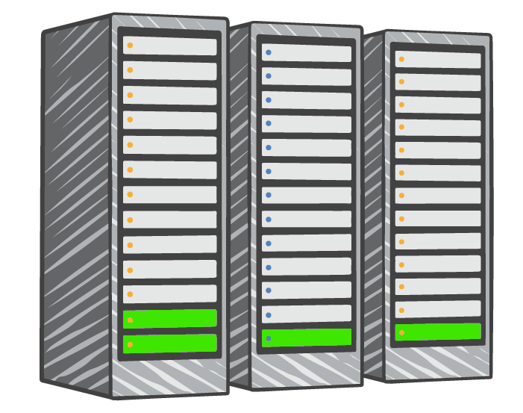

Stop guessing capacity
Overestimated server capacity
Underestimated server capacity
Scaling on demand
Notes:
Advantage #3—Stop guessing capacity: Eliminate guessing about your infrastructure capacity needs. When you make a capacity decision before you deploy an application, you often either have expensive idle resources or deal with limited capacity. With cloud computing, these problems go away. You can access as much or as little as you need, and scale up and down as required with only a few minutes’ notice.

Slide 37
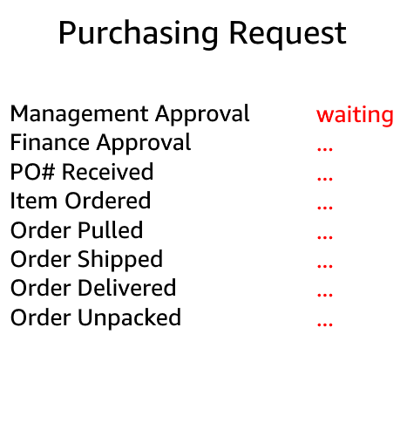
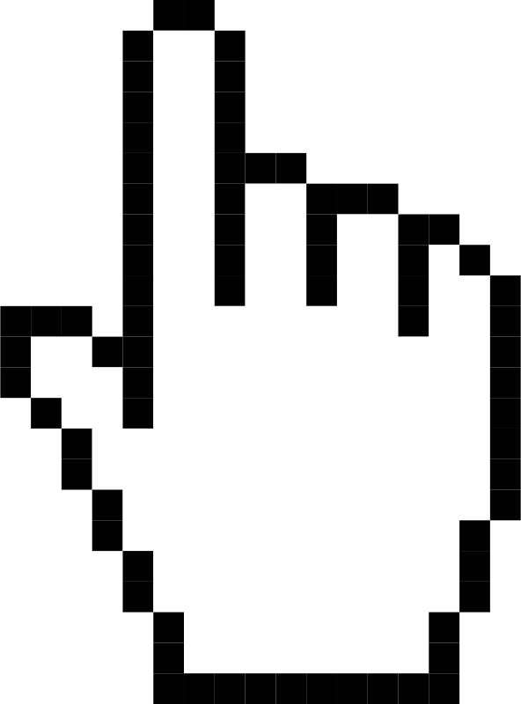
Increase speed and agility
Launch
Weeks between wanting resources and having resources
Minutes between wanting resources and having resources
Notes:
Advantage #4—Increase speed and agility: In a cloud computing environment, new IT resources are only a click away, which means that you reduce the time it takes to make those resources available to your developers from weeks to just minutes. The result is a dramatic increase in agility for the organization because the cost and time that it takes to experiment and develop are significantly lower.
Example: Running machine learning application with huge datasets.

Slide 38
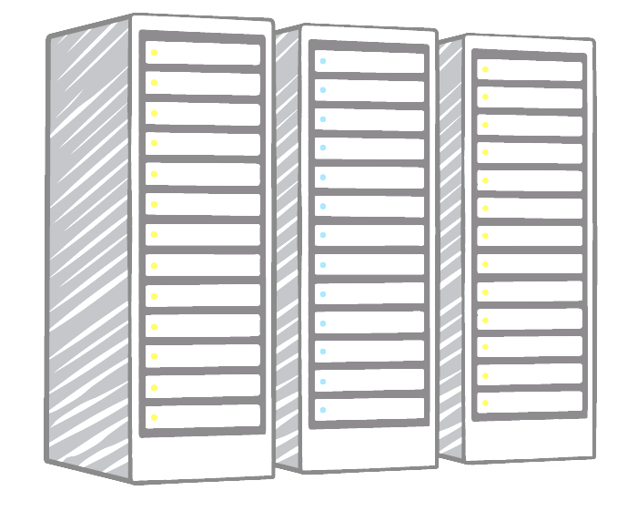
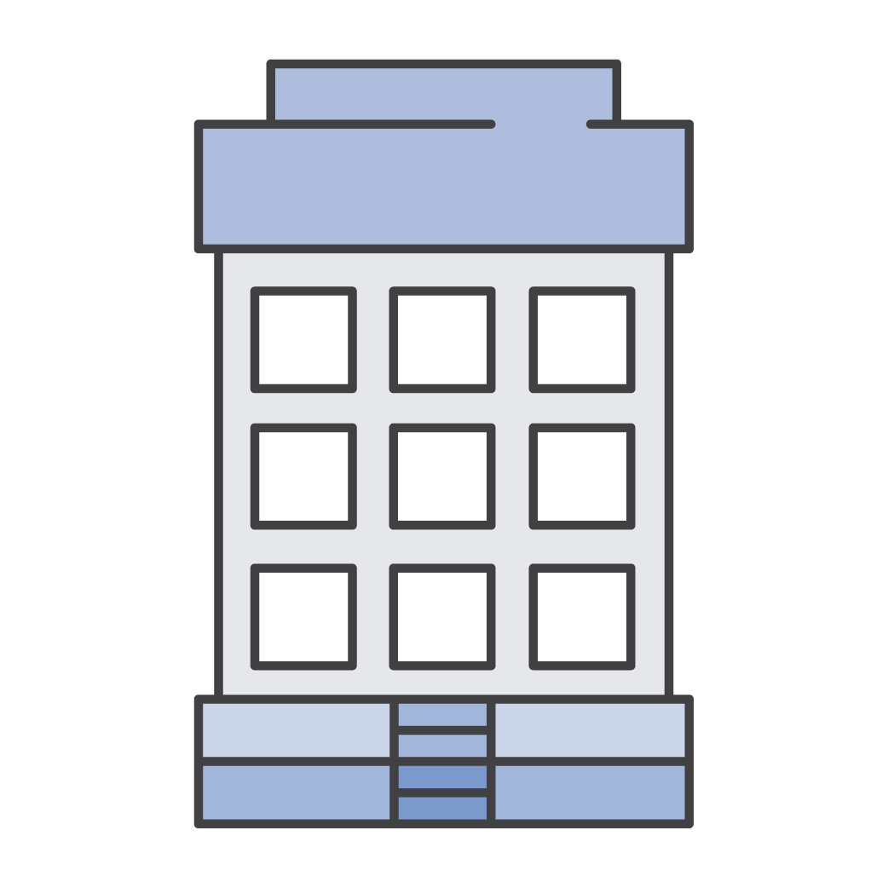


Stop spending money on running and maintaining DCs
Payroll …. … .. … …. … .. … …. … .. … …. … .. … …. … .. … …. … .. …
Utilities …. … .. … …. … .. … …. … .. … …. … .. … …. … .. … …. … .. …
Maintenance …. … .. … …. … .. … …. … .. … …. … .. … …. … .. … …. … .. …
Landscaping …. … .. … …. … .. … …. … .. … …. … .. … …. … .. … …. … .. …
Hardware …. … .. … …. … .. … …. … .. … …. … .. … …. … .. … …. … .. …
Investment
Running data centers
Business and customers
Notes:
Advantage #5—Stop spending money on running and maintaining data centers: Focus on projects that differentiate your business instead of focusing on the infrastructure. Cloud computing enables you to focus on your own customers instead of the heavy lifting of racking, stacking, and powering servers.

Slide 39
Go global in minutes
You can deploy your application in multiple AWS Regions around the world with just a few clicks.
As a result, you can provide a lower latency and better experience for your customers simply and at minimal cost.
For example, for customers in Pakistan, services will be provided UAE region and for customers in Netherlands, services will be provided from West Europe region.
Can we provide services to customer in Netherlands from UAE region? What will be consequences?

Slide 40
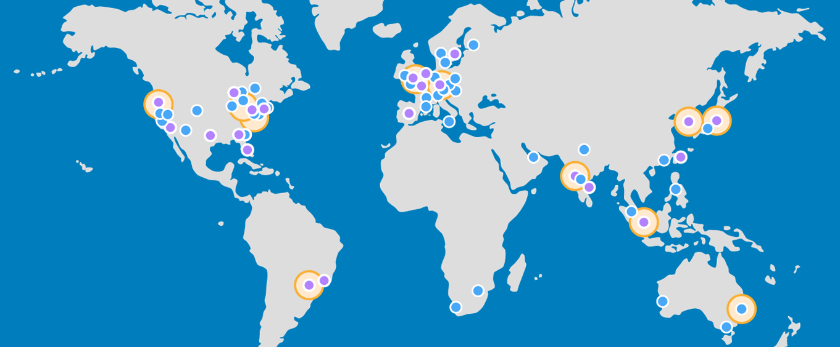

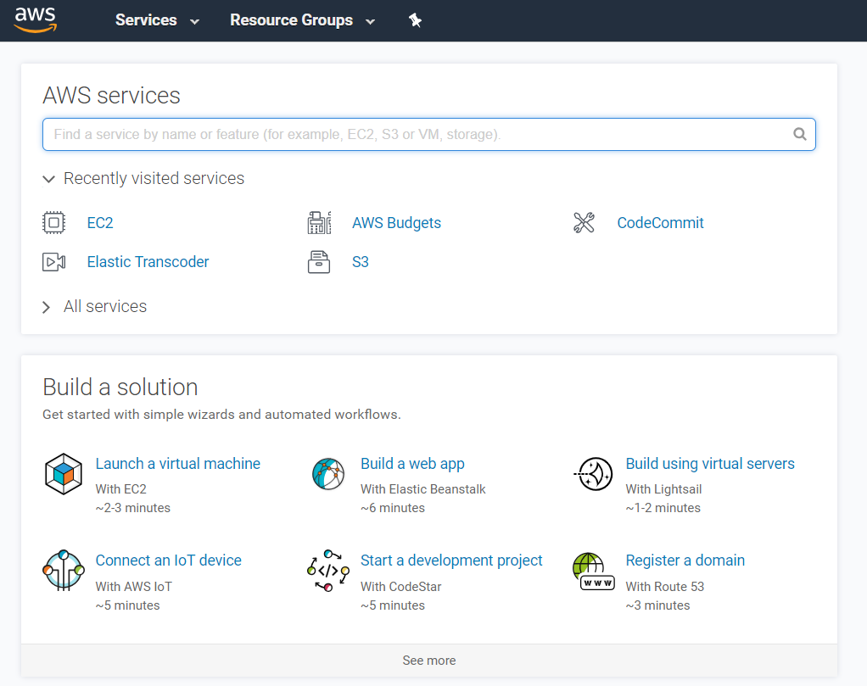
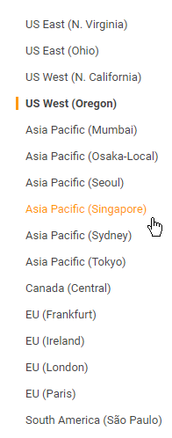
Go global in minutes

Slide 41
Section 2 key takeaways
Trade capital expense for variable expense
Benefit from massive economies of scale
Stop guessing capacity
Increase speed and agility
Stop spending money on running and maintaining data centers
Go global in minutes
Notes:
The key takeaways from this section of the module include the six advantages of cloud computing:
Trade capital expense for variable expense
Massive economies of scale
Stop guessing capacity
Increase speed and agility
Stop spending money on running and maintaining data centers
Go global in minutes

Slide 42
Thank You
Notes:
Thanks for participating!

